Slide 1
Making this resource work for you
Prior to teaching this lesson, please refer to the ‘Unit Overview and Planning Document’.
Further guidance on planning Science Mastery lessons can be found in the detailed planning guidance document.
Refer to the ‘notes’ section on each slide for useful information, including suggested expositions, pedagogical content knowledge, suggested questions, answers and more. Consider using presenter mode so you can see this guidance throughout the lesson.
The introduction slides can be adapted to suit your teaching style and the needs of your class.
Before the lesson, adapt the fix-it slide to address any misconceptions identified in the previous lesson’s exit ticket.
Choose from the suggested activities to suit your class. The intention is not that you complete all of these, but that you select those which ones are most appropriate for your students. It may be appropriate to further adapt activities for your students.
These lessons are designed to occupy approximately 1 hour. To adapt for a shorter or longer lesson duration we advise you to adapt the activity section accordingly.
Please consider using the final slide to send feedback about this lesson or examples of PowerPoints that you have adapted to our design team. Your feedback is used to improve Science Mastery for all of our teachers and students. We appreciate all suggestions and comments.
Thank you for reading!
The Science Mastery Team

Slide 2
Cell Division
Answer the questions below.
Arrange the following in increasing size order: cell, DNA, nucleus. From smallest to largest.
Explain why new cells have to be made.
Explain the difference between unicellular and multicellular organisms.
State the location of genetic material in eukaryotic cells.
Many species of animals and plants have chromosomes in pairs. Explain why this is.
DNA, nucleus, cell
For growth and to replace damaged or lost cells.
Unicellular organisms are made up of one cell only whereas multicellular organisms can be made up of any number of cells.
Nucleus
They inherit one chromosome from each pair from each parent.
Notes:
Foundation: Where is DNA found in prokaryotic cells?
Stretch: Why is it useful for a species to have variation in its population?
Answers:
Foundation: In plasmids and loops
Stretch: More variation makes a population more resilient to change, including having more resistance to disease.

Slide 3
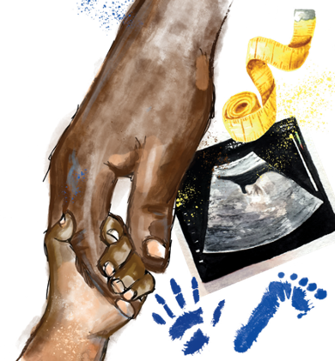
B3.1.12
12/04/2024
Cell Division
B3.1.1 Prior Knowledge Review
B3.1.2 Eukaryotic and Prokaryotic Cells
B3.1.3 Aseptic Technique
B3.1.4 Growth of Bacteria
B3.1.5 Microscopes
B3.1.6 Observing Cells
B3.1.7 Diffusion
B3.1.8 Diffusion in Living Things
B3.1.9 Osmosis
B3.1.10 Osmosis Investigation
B3.1.11 Active Transport
B3.1.12 Cell Division
B3.1.13 Cancer
B3.1.14 Stem Cells
Notes:
Big Idea: Cells are alive
So far in this unit pupils have looked at properties and processes that involve eukaryotic and prokaryotic cells. In this lesson pupils will learn about the process of cell division and mitosis as part of this. This will then feed into the next lesson about cancer, an example of when cell division goes wrong.
Suggested Hook:
When we injury ourselves our body needs to repair itself. Our skin may need to regenerate to close a wound, in order to do that our body has to produce new skin cells from existing ones. If this did not happen every cut we get could be at a big risk of infection and we would never heal!

Slide 4

Following this lesson, students will be able to:
State the three stages of the cell cycle
Describe how cells divide to produce two identical daughter cells
Explain the importance of the growth phase of cell division
Key Words:
cell division
mitosis
chromosome
daughter cells
asexual

Slide 5
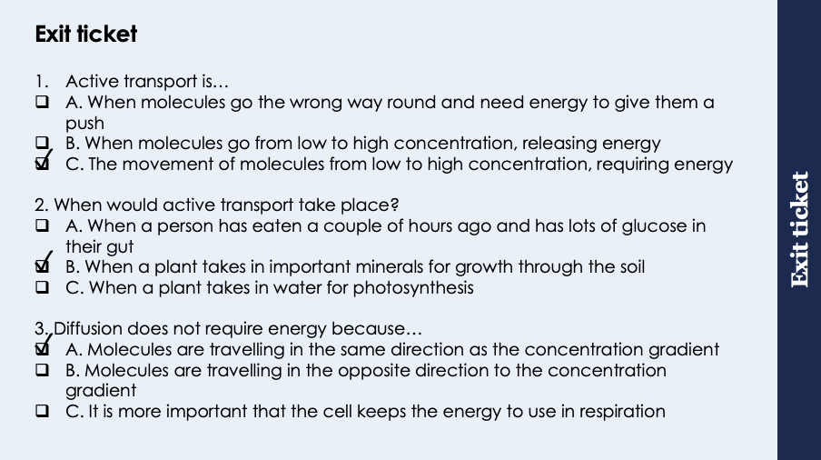
This is the fix-it portion of the lesson
The fix-it is an opportunity to respond to gaps in knowledge, especially those identified by the previous lesson’s exit ticket.
The teacher should customise this slide as needed, to facilitate
reteach, explanation, demonstration or modelling of ideas and concepts that students have not yet grasped or have misunderstood.
practise answering specific questions or of key skills.
redrafting or improving previous work.
Notes:
Purpose: to spend time on gaps identified in previous lesson’s exit ticket.
Answers:
Q1. Answer: C
If pupils answer A the have not understood the purpose of active transport. If they have answered B they have a misconception around energy being released where is should be used. To fix this ask pupils to write a definition of active transport and explain why te energy is necessary. You could refer beck to the slide and concentration gradient analogy in notes section on slide 7.
Q2. Answer: B
If pupils have answered A they have mistaken diffusion for AT, if they have answered C they have mistaken osmosis for AT. To fix this have pupils write out the definitions of diffusion, osmosis and active transport. They could discuss the ways in which the processes are different from each other.
Q3. Answer: A
If pupils have answered B they may have confused diffusion and AT, if they have answered C they have a misconception around why energy is required in AT but not in diffusion. To fix this get pupils to draw a table with similarities and differences for diffusion and active transport, with examples of each. Highlight the ‘active’ part of AT and emphasise diffusion is passive. You could refer beck to the slide and concentration gradient analogy in notes section on slide 7.

Slide 6
What is in the nucleus?
The nucleus consists of chromosomes and their genes which are made of a molecule called DNA.
A gene is a small section of DNA that controls a characteristic of your body (e.g. eye colour). Different versions of genes are called alleles.
The genes are grouped together on chromosomes (there may be thousands of genes on one chromosome).
Notes:
Purpose: to introduce the idea of chromosomes within the nucleus before cell division is introduced. This will probably be the first time students have heard the term ‘chromosomes’.
Type of exposition: Explanation
Suggested script:
DNA is located inside the nucleus of eukaryotic cells. Small sections of that DNA that code for an organisms particular characteristics are known as genes. DNA is a very large molecule (if you could stretch out all the DNA from one nucleus, into one straight line it would reach about 2 m!), so that it all fits into the nucleus it is wound up tightly into structures called chromosomes (point to the chromosome on the diagram). The mass of DNA in a cell can be measured in picograms (1 picogram = 0.000000001g)!
In the regular cells (as opposed to gametes) of organisms that reproduce via sexual reproduction there are 2 sets of chromosomes, one set originating from the female gamete and the other from the male gamete that fused during fertilisation. Human gametes contain 23 chromosomes therefore human body cells contain 46 chromosomes arranged as 23 pairs. For more higher attaining classes introduce the words diploid and haploid. A diploid cell contains two sets of chromosomes, a haploid cell (gamete) contains only one set of chromosomes. Chromosomes are very dense and can therefore be seen under the microscope, we will see a microscopic video later on.
What about prokaryotic cells? Prokaryotes do not have a nucleus, their DNA is found in small plasmids or larger free DNA.

Slide 7
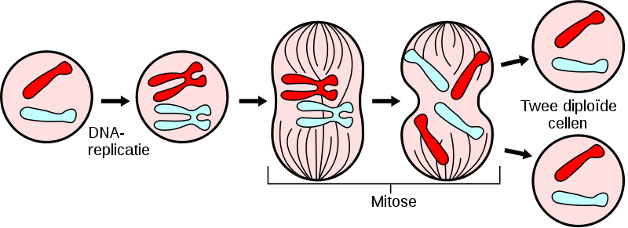

Cell Division
Cell division is used by multicellular organisms to grow and repair.
It is also used by organisms that reproduce asexually, such as bacteria.
Cells increase in number by dividing into 2.
The process of cell division includes a growth phase, where the cell doubles its sub-cellular structures and DNA, before it splits in two
Two diploid cells
DNA replication
Mitosis
Notes:
Purpose: introducing new knowledge
This lesson is concerned with mitosis. Meiosis will be covered in a later unit (B3.3).
Link back to growth of bacteria calculation earlier in this unit – every cell division produces 2 cells, hence why we use an exponential calculation
Type of exposition: Explanation
Suggested script:
Cells are constantly going through a cycle called the cell cycle. This cell cycle will last for varying amounts of time depending on the type of cell, most cell cycles in mammals last somewhere around 24 hours (when growing in vitro, which means in Petri dishes in the lab) whereas the cell cycle for yeast can be shorter than 2 hours!
There comes a time in the cell cycle where a cell will need to divide into two new identical cells. Cells need to divide for different reasons. Some organisms (such as bacteria) reproduce asexually by splitting into two new cells. In multicellular organisms cells need to divide so that the organism can grow bigger and also so that any cells or tissues in the organism that are damaged can be repaired by new cells. Some organs (such as the skin) constantly require new cells so rely on cell division.
Before a cell can divide into two new cells it needs to go through the ‘growth phase’ of the cell cycle. During this growth phase the number of organelles inside the cell double (or replicate). This includes the nucleus, as a new nucleus is needed for the new cell all of the DNA inside the cell must also be replicated.
Why do you think this growth phase is important? So that the cell is big enough and has the correct number of organelles to divide. If it did not go through a growth stage each new cell produced would have half the genetic material/subcellular structures as its predecessor, then infinitely half. Definition of a species is a group of organisms that can breed to produce fertile offspring, therefore requiring the parents to have equal numbers of chromosomes.
Watch the video linked here: https://www.youtube.com/watch?v=2LBpF71GZbk
Note: Students are not required to know the stages of mitosis.
Identify the structures moving, lining up and then splitting into separate cells as chromosomes.
Suggested script during the video:
The nucleus needs to divide in two to form two new cells, this means that all of the DNA needs to replicate. Once the DNA has replicated there will be double the number of chromosomes in the cell. The process in this video is showing the chromosomes lining up and splitting up. This process of chromosomes splitting is known as mitosis which is another phase in the cell cycle (that occurs after the growth phase).
Meiosis is covered in a later unit and so is not required here.
Image: https://commons.wikimedia.org/wiki/File:Major_events_in_mitosis_NL.svg

Slide 8
Cell Division
After the growth phase where DNA has been replicated the chromosomes are pulled apart to separate ends of the cell, ready for division
The final part of the cell cycle is the splitting of the cell membrane to produce two identical cells
Two diploid cells
DNA replication
Mitosis
Notes:
Purpose: introducing new knowledge
Type of exposition: Explanation
Like we saw in the video, once replicated, all of the chromosomes line up (point to the central image of chromosomes lining up). Each copy of a chromosome is then pulled towards opposite ends of the cell by spindle fibres. This part is known as mitosis. The final part of the cell cycle occurs when the cell membrane divides and encloses the chromosomes at each end. Two identical (diploid) daughter cells are produced. Each daughter cell has the same number of chromosomes that the original cell had.
Key point to emphasise – the whole process is not mitosis. The whole process is cell division, mitosis is specifically the phase that involves the splitting of the DNA. DNA replication happens in the growth phase.

Slide 9
Determine whether each statement is true or false.
Cell division with mitosis is used by multicellular organisms to reproduce asexually
During mitosis DNA is replicated
At the end of cell division with mitosis four identical cells are produced
Cell division with mitosis can be used for growth and repair
The cells produced at the end of cell division with mitosis have half the number of chromosomes as the original cell.
False
False
False
True
False
Notes:
Purpose: assess understanding of new information and key prior knowledge. Get students to hold up thumbs up or down for true/false. Take consensus with answers and use questioning to explain why these are the answers and correct false statements.
Answers:
False – multicellular organisms more commonly reproduce sexually, unicellular organisms reproduce asexually
False- DNA is replicated during the growth phase
False – 2 identical cells are produced
True
False – they have the same number. Meiotic daughter cells (sex cells) have half the number of chromosomes.

Slide 10




Which statements do you agree with?
I think that unicellular organisms use mitosis to replace damaged cells
I think that chromosomes are pulled to opposite ends of the cell during mitosis
I think that the growth phase is important so that the two daughter cells have the same amount of DNA as the parent cell
I think that DNA is replicated during mitosis
Notes:
Ask students to discuss the statements in their pairs and decide which they agree with.
Blue and pink are true
Yellow is false – a unicellular organism replacing a cell is impossible (it is made of one cell!) Unicellular organisms use mitosis to reproduce asexually
Green is false – DNA is replicated during the growth phase (interphase)
Suggested guidance:
Talk tasks can be used in a variety of ways to suit the particular needs of the students you are teaching. Through exchanging views with others, students develop their understanding of the science beyond what could be achieved individually.
Science classrooms that successfully integrate talk have the following features:
Science talk is a regular feature of lessons and is woven into classroom activities.
Students are paired or grouped strategically by the teacher to ensure productive interaction. This might take into consideration the students’ proficiency of the English language, how encouraging they might be to peers and their attainment in the topic. It’s a good idea to consider these pairings in the class seating plan.
Students are encouraged and supported to talk, but are not forced to talk.
The teacher should take on the role of a facilitator, engaging with conversations where necessary and encouraging or steering the conversation where needed.
Students are encouraged to use the language they have to express their ideas (e.g., everyday language, imperfect English, native language), but also to incorporate science specific terminology where this is more accurate or has been taught.
6. Scientifically inaccurate ideas are not dismissed by the partner or teacher; open discussion and further investigation are relied on to help students construct ideas that support them to progress in their scientific understanding.
7. Guidelines for behaviour during talk tasks are explicit and frequently reviewed. Rules for students might be:
Listen carefully to your partner
Take turns talking.
Speak one at a time, without interrupting.
Politely agree or disagree and explain why.
Politely point out if your partner has used a scientific word incorrectly, if they have explained the science incorrectly, or if there is a more accurate way to describe something.
If confused, ask questions.
Stay focused on the discussion topic.
Respond to one another.

Slide 11
Drill
Define a gene.
State where in the cell genes are found.
Explain why cell division is important for multicellular organisms.
State how many daughter cells are made from cell division of one cell.
State one change to the DNA that occurs at the start of cell division.
State if the daughter cells are identical or non-identical.
State the number of chromosomes in a normal human cell.
State the number of chromosomes in a human cell produced from mitotic cell division.
Notes:
Purpose: This is a knowledge drill. The purpose of this is to check that the critical knowledge is secure before pupils move onto independent practice.
Suggested guidance: There are a range of ways this could be done depending on time and ability range of the class:
Mini whiteboards
As full sentences in exercise books
As short answers in exercise books
In the pupil workbook
As pair talk
As cold call

Slide 12
Drill answers
A gene is a small section of DNA that controls a characteristic of your body (e.g. eye colour). Different versions of genes are called alleles.
The nucleus
Growth and repair
Two cells
DNA replication
Identical
46
46
Notes:
Purpose: This is a knowledge drill. The purpose of this is to check that the critical knowledge is secure before pupils move onto independent practice.
Suggested guidance: There are a range of ways this could be done depending on time and ability range of the class:
Mini whiteboards
As full sentences in exercise books
As short answers in exercise books
In the pupil workbook
As pair talk
As cold call

Slide 13

I: Describe to recall facts, events or processes in an accurate way
Example question:
To ‘describe’, your answer should:
Use bullet points.
Include each step of the process in a logical order.
Use keywords throughout the answer
Stay focused on the question.
Describe the cells produced of mitotic cell division.
Model answer:
Two genetically identical daughter cells
Each containing the same number of chromosomes as the parent cell
Notes:
This slide models the process of answering a describe question.
Firstly, students are presented with a generic describe question, along with a model answer. Students are also given some simple guidance to follow for producing their own describe answer.
The generic question and answer should be used by the teacher to remind students of
the key features of a great answer
how to structure their answer
why the model answer is a good example
Following this, students will be required to apply this process to answer their own describe question, which will appear in place of the generic questions. This describe question will be specific to the topic students are learning about in the lesson. Give students time to write their own answer to this, ensuring that they use the guidance provided. To further scaffold this task for students, it may be appropriate to:
pair students up to write an answer together
list for students the key words you would like them to include in the answer
provide a writing frame or ‘points to include’ for students
A model answer for this question will appear. Teachers should review the model answer with students by referencing the guidance in the green box. For example ‘we can see item 1 in the guidance is to use bullet points to keep your answer clear. Notice in the model answer here we have done just that’. Or ‘item 2 in the guidance here says that we should use scientific keywords in the answer. Has this been achieved in the model answer? Where can we see this?’.

Slide 14
We: Describe to recall facts, events or processes in an accurate way
Example question:
To ‘describe’, your answer should:
Use bullet points.
Include each step of the process in a logical order.
Use keywords throughout the answer
Stay focused on the question.
Describe what mitotic cell division is used for.
Model answer:
In multicellular organisms it is used for growth and repair
In unicellular organisms it is used for asexual reproduction
Notes:
This slide models the process of answering a describe question.
Firstly, students are presented with a generic describe question, along with a model answer. Students are also given some simple guidance to follow for producing their own describe answer.
The generic question and answer should be used by the teacher to remind students of
the key features of a great answer
how to structure their answer
why the model answer is a good example
Following this, students will be required to apply this process to answer their own describe question, which will appear in place of the generic questions. This describe question will be specific to the topic students are learning about in the lesson. Give students time to write their own answer to this, ensuring that they use the guidance provided. To further scaffold this task for students, it may be appropriate to:
pair students up to write an answer together
list for students the key words you would like them to include in the answer
provide a writing frame or ‘points to include’ for students
A model answer for this question will appear. Teachers should review the model answer with students by referencing the guidance in the green box. For example ‘we can see item 1 in the guidance is to use bullet points to keep your answer clear. Notice in the model answer here we have done just that’. Or ‘item 2 in the guidance here says that we should use scientific keywords in the answer. Has this been achieved in the model answer? Where can we see this?’.

Slide 15
You: Describe to recall facts, events or processes in an accurate way
Example question:
To ‘describe’, your answer should:
Use bullet points.
Include each step of the process in a logical order.
Use keywords throughout the answer
Stay focused on the question.
Describe the process of mitotic cell division.
Model answer:
DNA replicates
Chromosomes are pulled apart
Cell membrane divides to produce two identical cells
Notes:
This slide models the process of answering an explain question.
Firstly, students are presented with a generic explain question, along with a model answer. Students are also given some simple guidance to follow for producing their own describe answer.
The generic question and answer should be used by the teacher to remind students of
the key features of a great answer
how to structure their answer
why the model answer is a good example
Following this, students will be required to apply this process to answer their own explain question, which will appear in place of the generic questions. This explain question will be specific to the topic students are learning about in the lesson. Give students time to write their own answer to this, ensuring that they use the guidance provided. To further scaffold this task for students, it may be appropriate to:
pair students up to write an answer together
list for students the key words you would like them to include in the answer
provide a writing frame or ‘points to include’ for students
A model answer for this question will appear. Teachers should review the model answer with students by referencing the guidance in the green box. For example ‘we can see item 1 in the guidance is to begin with a scientific statement. Notice in the model answer here we have done just that’. Or ‘item 2 in the guidance here says that we should use a linking statement in the answer. Has this been achieved in the model answer? Where can we see this?’.

Slide 16
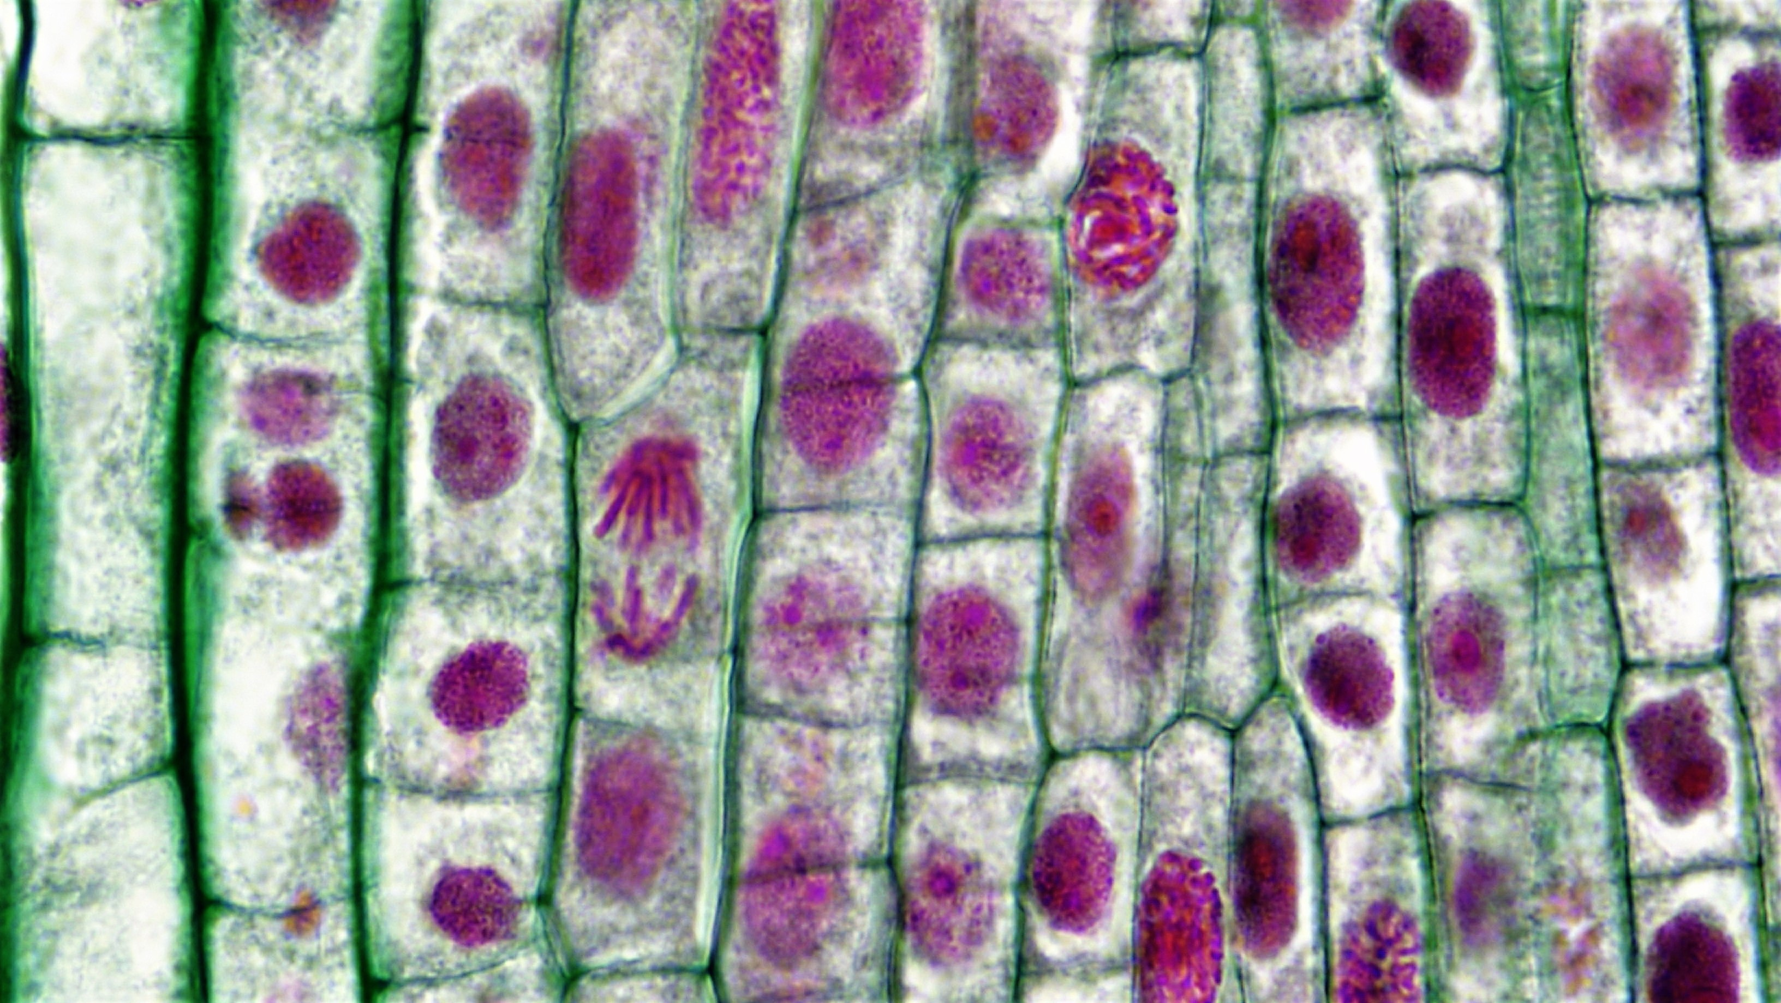
Demonstration: Investigating mitosis in allium root tip squash
Notes:
This is a demonstration outlined by RSB here: https://pbiol.rsb.org.uk/cells-to-systems/cell-division/investigating-mitosis-in-a-root-tip-squash
Teacher guidance:
Talking about what chromosomes do during mitosis could be very interesting, but seeing them for yourself adds an extra dimension. There are several protocols available for this work and it is notoriously unreliable – often you will not find many dividing cells at all. The allium roots need to be prepared 1-10 days in advance of the lesson. Some practitioners report that cutting the root tips around noon makes a difference to the mitotic index, so you may want your technician to cut and ‘fix’ the tips in ethanoic alcohol. If you have access to a video microscope it is worth capturing some images, as this procedure can be frustrating.
Safety notes: Ethanoic ethanol is corrosive, so wear eye protection (goggles). Ethano-orcein stain contains ethanoic acid and also requires you to wear goggles when it is dispensed. You should wear eye protection when handling hot hydrochloric acid. Take care with scalpels and always carry them on a white tile.
Image: https://commons.wikimedia.org/wiki/File:Mitotic_Stages_in_Apical_Meristem_of_Allium_Root_Tip_(36762516673).jpg

Slide 17
Cell Division
Complete the cell division worksheet
Use full sentences and keywords where necessary
Ensure you write in a concise and scientific way
Two diploid cells
DNA replication
Mitosis
Notes:
Self/peer assessment using markscheme

Slide 18
Answer the questions below.
1. Mitosis is…
A. the process of making new cells
B. the process of cells dividing their genetic material to make two new cells
C. the process of cells replicating their DNA and sub-cellular structures
2. Which is a stage of cell division?
A. Replication of DNA and sub-cellular structures
B. One cell being replaced by a newer cell
C. A cell producing two new cells alongside it
3. Which best describes the cells that are produced at the end of cell division with mitosis?
A. Two daughter cells with half the number of chromosomes as the original cell
B. Two daughter cells with the same number of chromosomes as the original cell
C. One daughter cell with double the number of chromosomes as the original cell
✓
✓
✓
Notes:
Purpose: to find out if students are able to answer key questions that check for understanding of the new information that have been covered.
Answers:
Q1. Answer: B
If pupils have answered A they have the misconception that mitosis is the whole process of cell division. If they have answered C they have the misconception that mitosis involves the replication phase of cell division. To fix this go through the process of cell division again and highlight that mitosis is the phase where chromosomes line up and split- it is not the whole process.
Q2. Answer: A
If pupils have answered B or C they have not understood that the cell cycle is separated out into phases. To fix this go through the process of cell division again and highlight each individual phase.
Q3. Answer: B
If pupils have answered A they have not appreciated that all DNA and therefore chromosomes have been replicated before mitosis. If pupils have answered C they have not thought about the final stage after mitosis where the cell membrane divides and envelopes the separated chromosomes forming two new cells. To fix this get pupils to draw a diagram of the cell at the start of cell division, before writing the steps and drawing diagrams of the resulting identical cells.

Slide 19
Lesson B3.1.12
What was good about this lesson? | What can we do to improve this lesson?
Send us your feedback by clicking this link
or by emailing sciencemastery@arkonline.org
Thank you!

